Slide 1
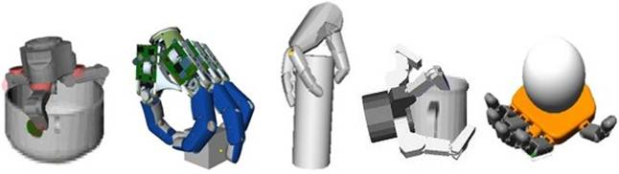
Tactile Sensing for Manipulation
TMM 201 Eleonora, Gojko, Carlo, Enrico
Contattaci: Slack #week8

Slide 2
(Eleonora)
Bioinspiration: a review of biological mechanoreception

Slide 3
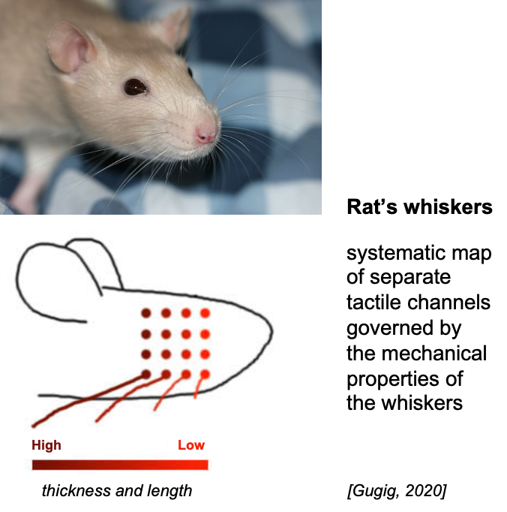
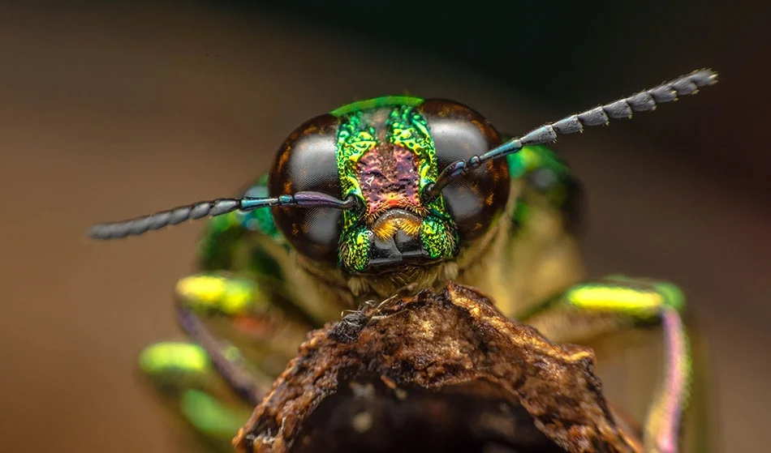
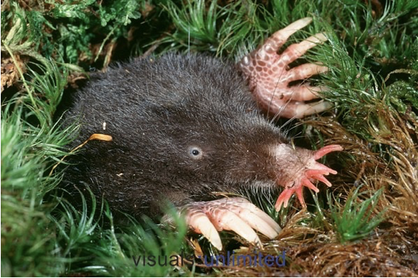
Tactile Sensing in Nature
Antennae
Star-nosed mole

Slide 4
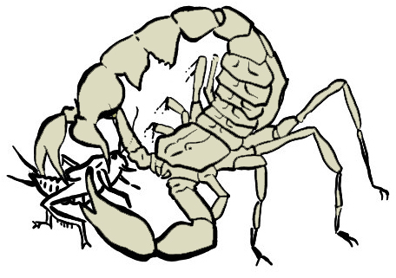
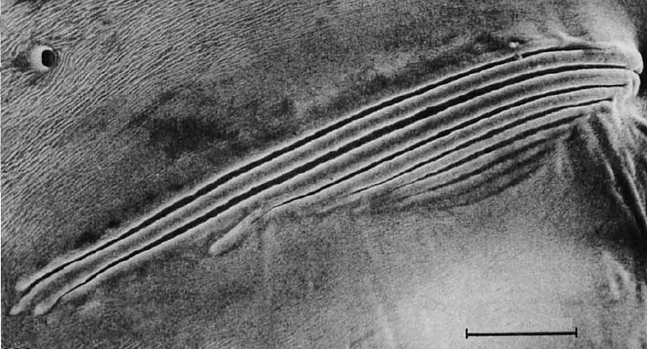
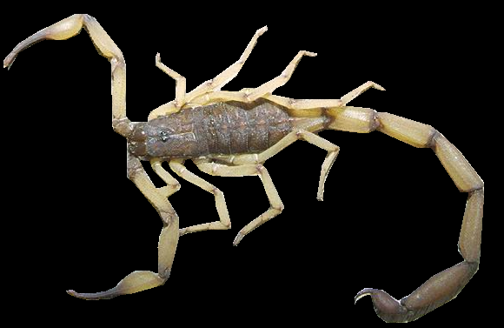
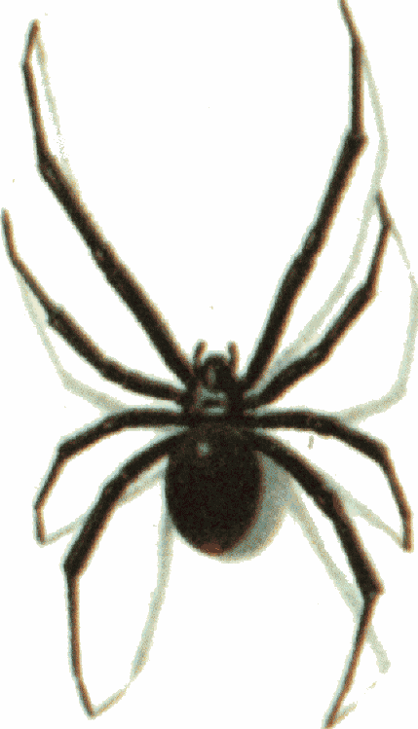
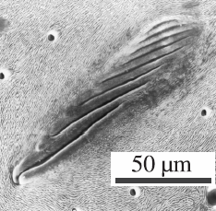
Tactile Sensing in Nature
[1]
Slit sense organs
Scorpion: 76 / leg
Spider: 224 / leg
Senses strains on the leg
Exoskeleton structures make the sensors possible (“intrinsic tactile sensing”)
Able to sense forces applied to areas elsewhere on the leg
Used in prey location - timing of spikes for 50m/s Rayleigh waves, ~300 Hz
Additional hair sensors give contact locations
10 μm
[2]
[1] F. G. Barth and M. Wadepuhl. Slit Sense Organs on the Scorpion Leg. Journal of Morphology, 145 (2): 209-227, 1975
[2] F. G. Barth and J. Stagl. The Slit Sense Organs Arachids. Zoomorphologie, 86:1-23, 1976
[3] W. Sturzl, R. Kempter, J.L. van Hemmen, Theory of Arachnid Prey Localization, Physical Review Letters, v. 84, n. 4, June 2000.

Slide 5

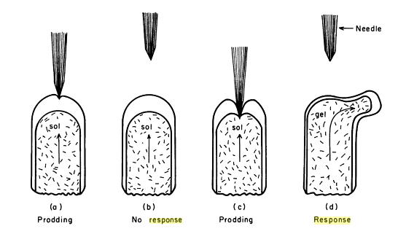
Amoeba touch response (even the simplest animals have tactile receptors)
hyaline
layer
membrane
granular
cytoplasm
I. Joan Lorch, Cha 1, in The Biology of the Amoeba,
Kwang Jeon, ed., Academic Press, NY, 1973.

Slide 6
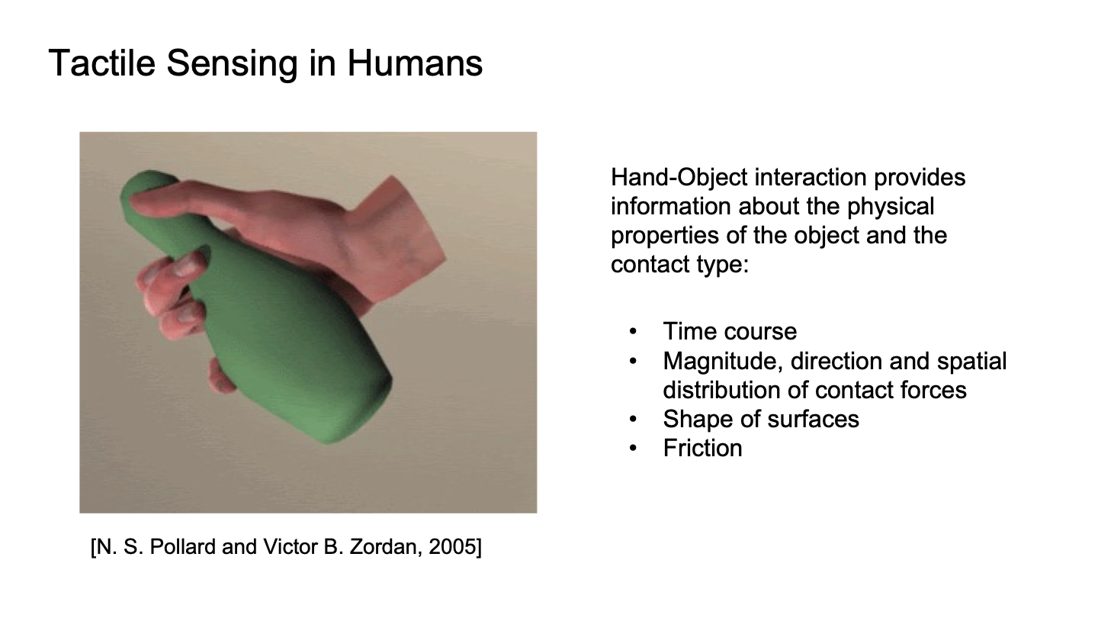

Slide 7
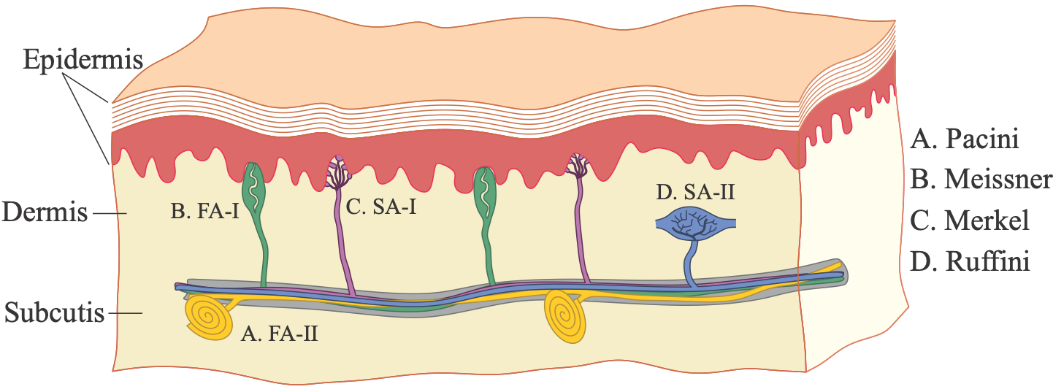
Human mechanoreceptors
M. R. Cutkosky, J. Ulmen, “Dynamic Tactile Sensing,” in The Human Hand: A Source of Inspiration for Robotic Hands, 2014.
Receptor | receptive field | frequency range | sensed quantity
FA-I Meissner corpuscles 140/cm^2 fingertips | 3-4mm | 5-60 Hz | dynamic skin deformation
SA-I Merkel endings 70/cm^2 | 3-4mm | 0-5 Hz | compressive stresses
FA-II Pacini corpuscles | >20mm | 50-500+ Hz (peak sensitivity ~250 Hz) | vibration
SA-II Ruffini endings | >10mm | 0-10 Hz | directional skin stretch

Slide 8
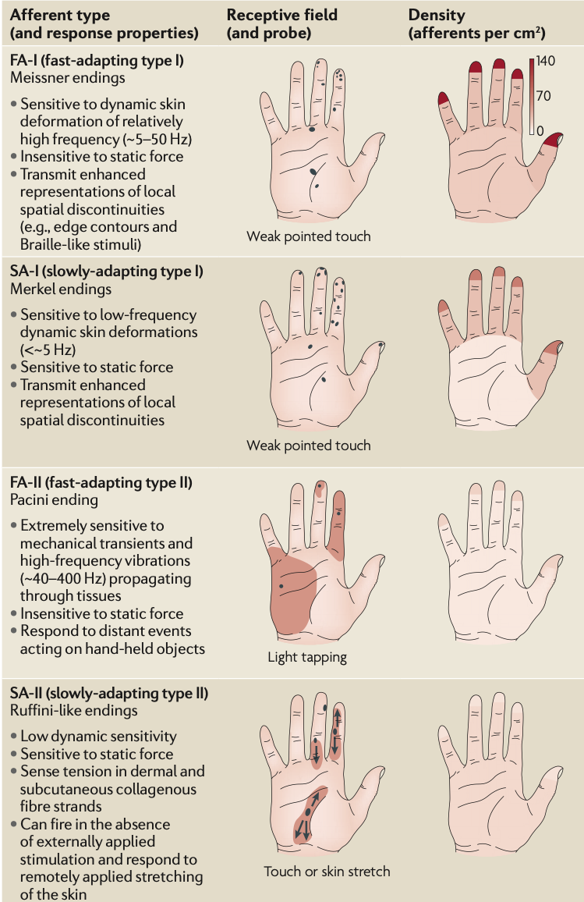
Mapping mechanoreceptors
[Cutkosky, Ulmen, ‘14]
R. S. Johansson, J. R. Flanagan, Coding and use of tactile signals from the fingertips in object manipulation tasks, Nature Reviews, 2009

Slide 9
Resolution
~ 17,000 mechanoreceptors in human hand
(>100,000 in star nosed mole, 6 along body in C. elegans respond to 10μN force)
Spacing of afferents at fingertips to 140/cm² for FA-I; 0.7mm mean spacing; receptive fields ~ 11mm².
Resolution: two-point discrimination = 1-2 mm
Gratings with spacings to approximately 1mm (finer spacing = “texture”)
Discrete bumps on smooth surfaces down to a few microns (e.g. checking imperfections in paint)

Slide 10
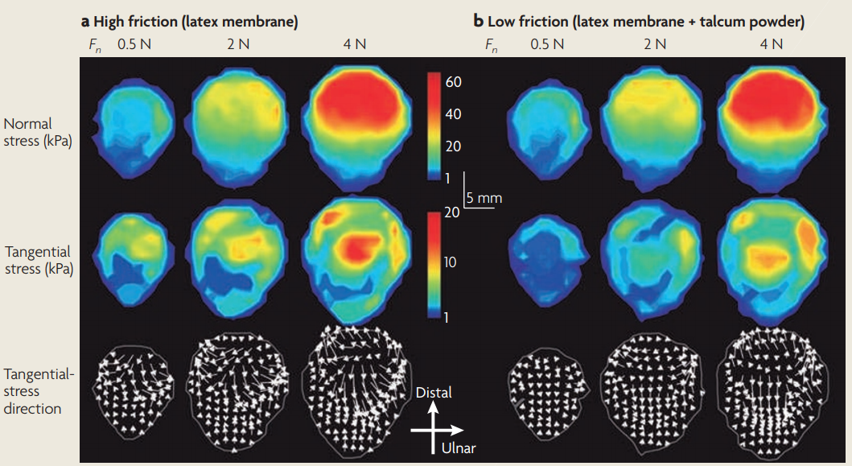
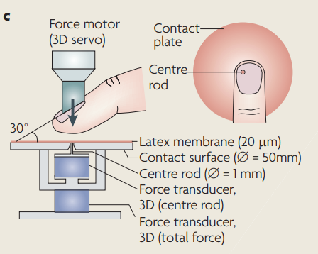
Complex mechanical properties of the fingertip
Slip and creep events constitute the basis for frictional encoding by tactile afferents: a slippery contact generally excites FA‐I afferents more strongly than a less slippery contact
[Johansson, Flanagan, ‘09]

Slide 11
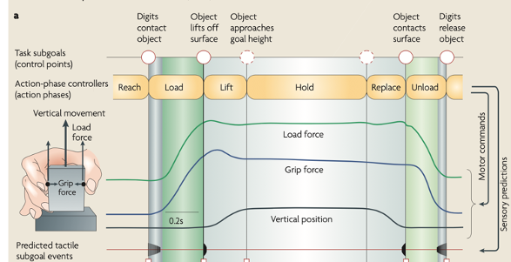
Tactile events in manipulation tasks
Dexterous manipulation is about balancing grip and load forces to object surface properties
[Johansson, Flanagan, ‘09]

Slide 12

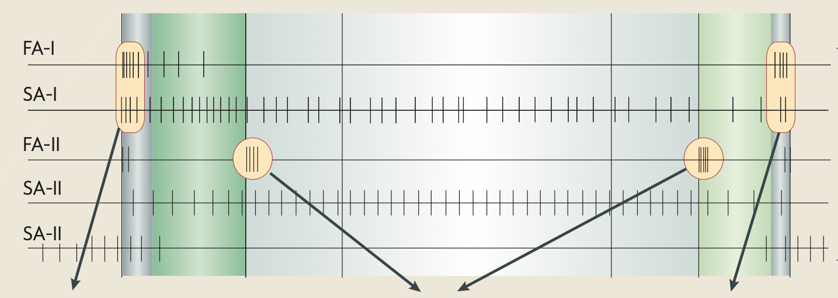
Tactile events in manipulation tasks
fingers contact object
object makes or breaks contact with surface
contact
released
[Johansson, Flanagan, ‘09]

Slide 13
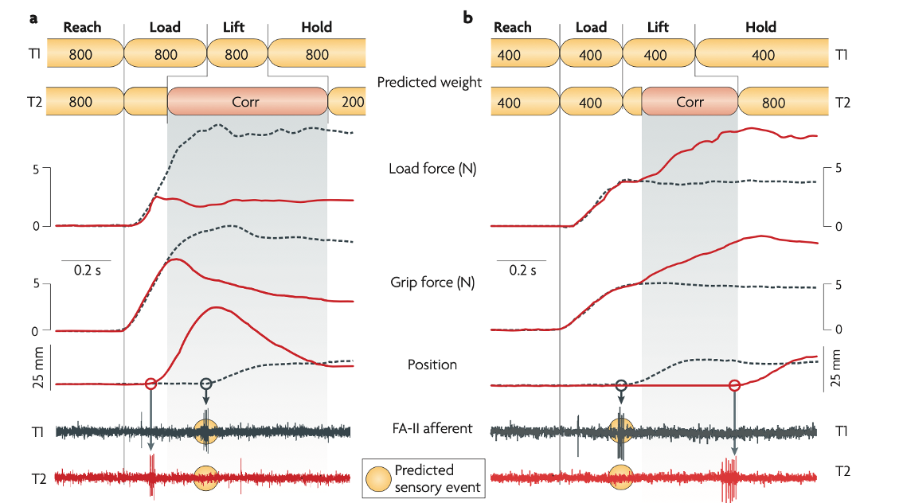
Prediction and Error Compensation
[Johansson, Flanagan, ‘09]

Slide 14
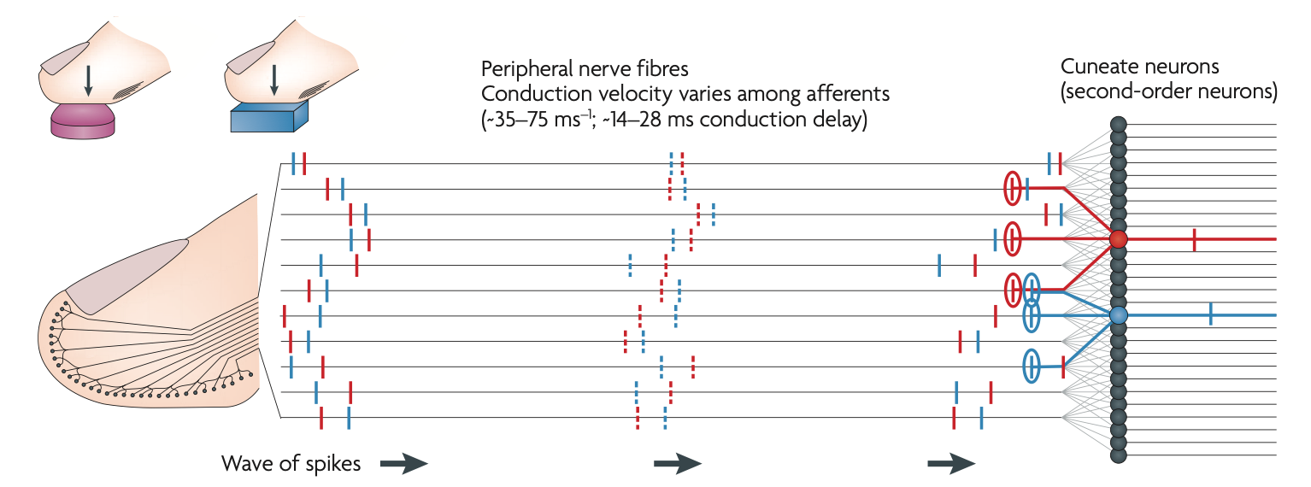
Timing and coincidence
Although nerve conduction is slow and spike frequency is moderate (~100/sec maximum), timing of first spikes can be interpreted at peripheral nerves to give cues about loading sequence (e.g. to predict surface shape).
[Johansson, Flanagan, ‘09]

Slide 15
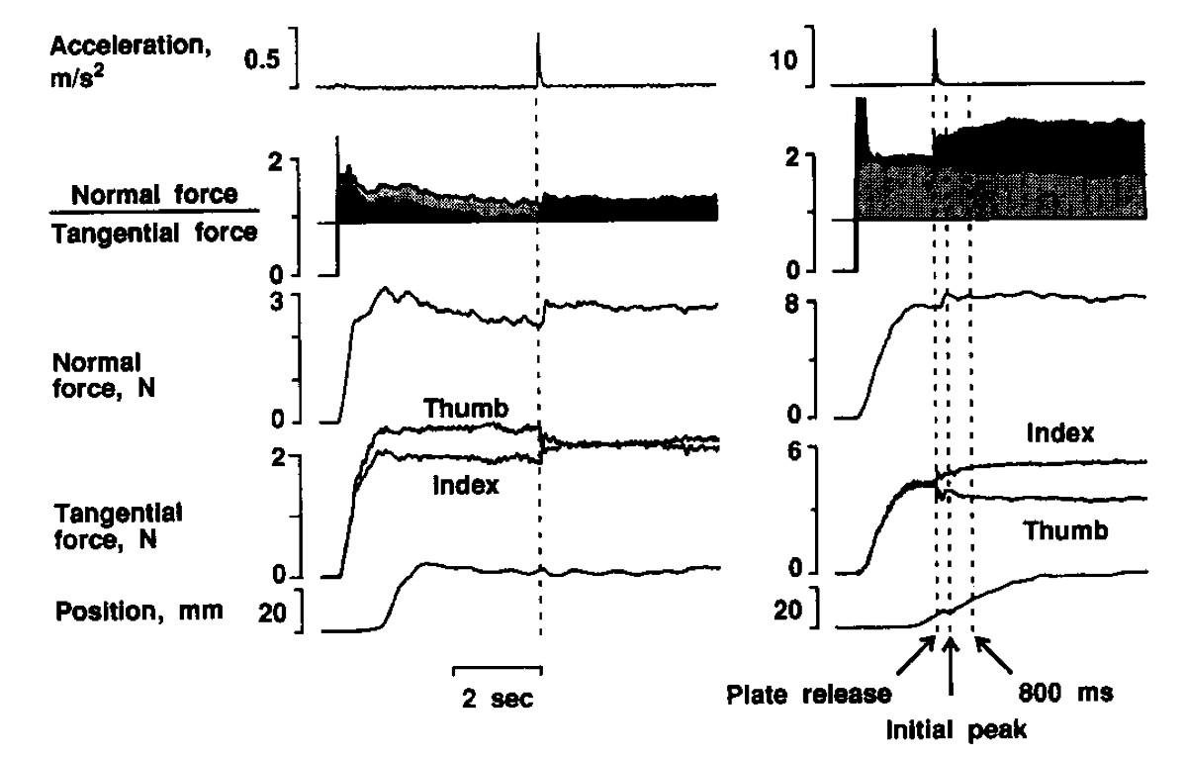
Grasp force regulation is based on slips and incipient slips
B. Edin, R. D. Howe, G. Westling, M.R. Cutkosky, Relaying Frictional Information to a Human Operator by Physiological Mechanisms, IEEE Trans. on Systems, Man and Cybernetics, 1993.
spontaneous slip: adjustment in ~80 ms
artificially induced slips - subjects did not habituate

Slide 16
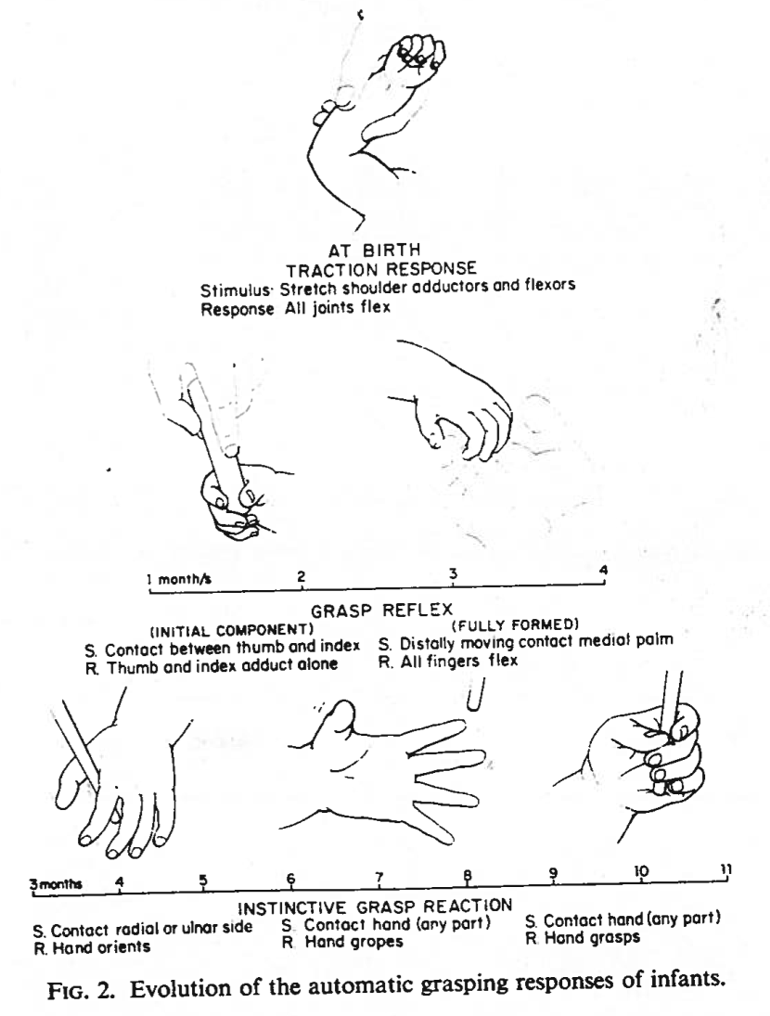
Grasping and sensing reflexes used to monitor normal infant development.
Twitchel, T.E, The Automatic grasping responses of infants,
Neuropsycholgia, Vol. 3, pp. 247-259 1965.

Slide 17
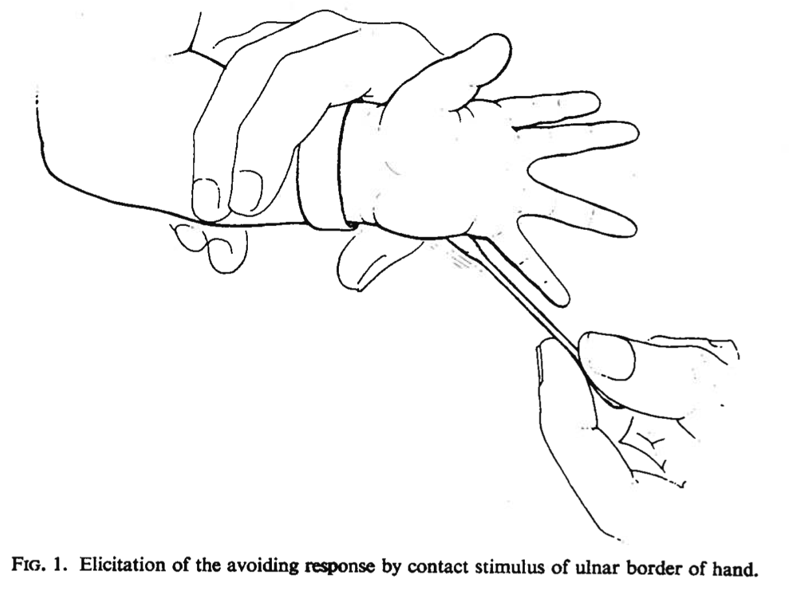
Avoidance
Twitchel, T.E, The Automatic grasping responses of infants,
Neuropsycholgia, Vol. 3, pp. 247-259 1965.

Slide 18
Tactile Sensing in Robotics: Overview
Why tactile sensing is important
Sensor types & what they measure
Tactile Information processing
(Carlo)
Billard, Aude, and Danica Kragic. "Trends and challenges in robot manipulation." Science 364.6446 (2019).
Cutkosky, Mark R., and William Provancher. "Force and tactile sensing." Springer Handbook of Robotics. Springer, Cham, 2016. 717-736.

Slide 19
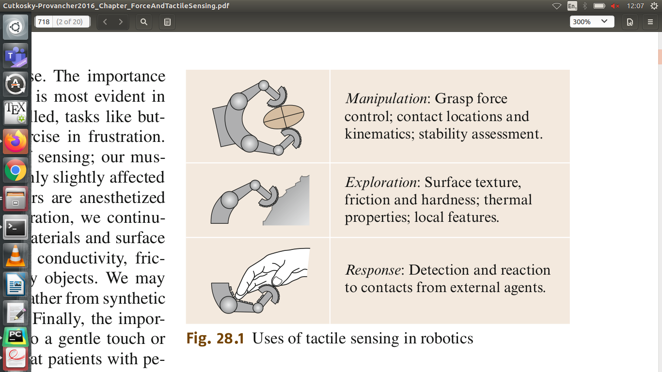
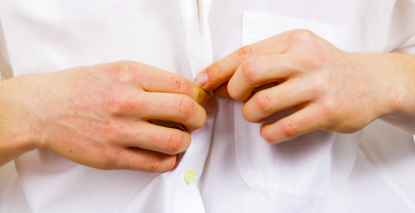
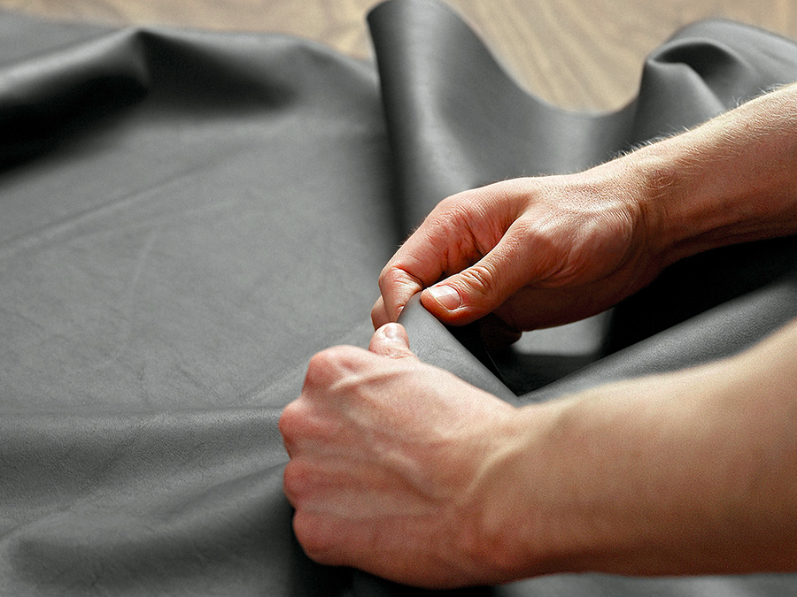

Why Tactile Sensing?
Three main activities:
Manipulation
Exploration
Response
A
A
B
B
C
C
Uses of tactile sensing in humans
Uses of tactile sensing in robotics

Slide 20
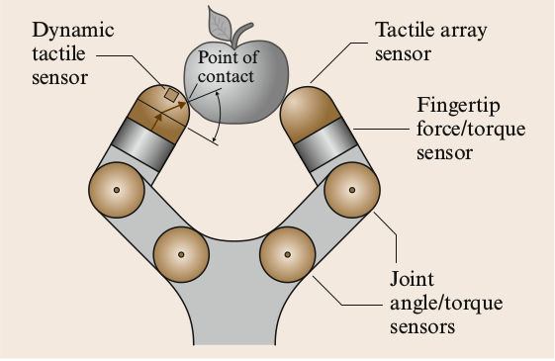
Types of Sensors
Most important measured quantities: force and shape
Average or distribution across contact area
5 main types of sensors
Proprioceptive
Kinematic
Force
Dynamic tactile
Array tactile
Other sensors:
Thermal, material composition, etc.
Sensors integrated in a robotic hand.

Slide 21
Proprioceptive and Proximity Sensing
Spatial proprioception To measure the net force or motion of an appendage.
Joint angle
Force-torque sensors
Proximity sensors To explore the environment, and detect collisions.
Contact (Whiskers & Antennae)
Non contact (Infrared, Ultrasonic, ...)
Robot hand with joint angle sensors.

Slide 22
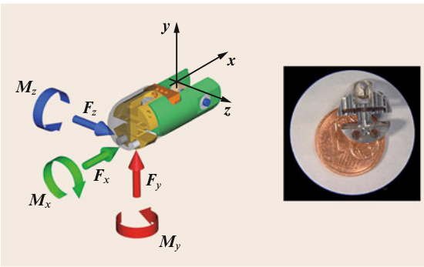
Force and Load Sensing
To measure contact forces.
Actuator Effort Sensors Servo motors → motor current Cables → cable tension
Force Sensors
Mounted at the base joint, wrist, or distributed.
Multi-axis fingertip force-torque sensor.
Force sensors + fingertip geometry to estimate contact location.

Slide 23
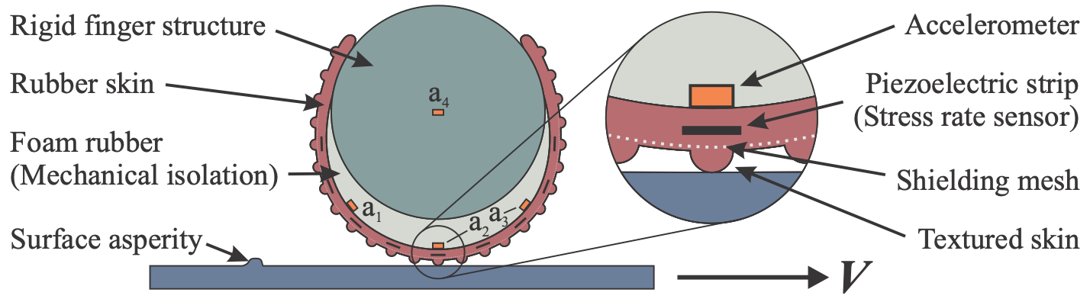
Dynamic Tactile Sensors
To detect slips, and to sense textures and features.
Ex. Capacitive tactile sensing (video)
Robot hand with dynamic tactile sensor.
Cutkosky, Mark R., and John Ulmen. "Dynamic tactile sensing." In The Human Hand as an Inspiration for Robot Hand Development, pp. 389-403. Springer, Cham, 2014.
Cutkosky, Mark R., and John Ulmen. "Dynamic tactile sensing." In The Human Hand as an Inspiration for Robot Hand Development, pp. 389-403. Springer, Cham, 2014.

Slide 24
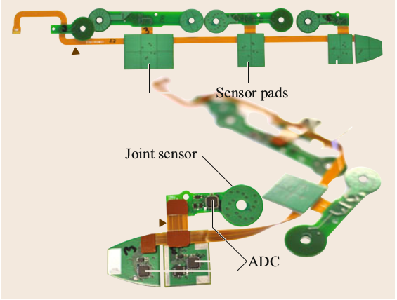
Array Sensors
To sense shape and pressure.
Contact Location Sensors
2D switch array
Pressure Sensing Arrays
Capacitive touch and joint angle sensors on a flexible circuit for incorporation in a robotic hand.
Ex. The effect of twice dropping, and then gently placing, a two-gram weight on a small capacitive tactile array. (video)

Slide 25
Tactile Information Processing
Contact locations and forces
Manipulation
Response
Exploration
Geometric and material properties of the object
Event detection

Slide 26
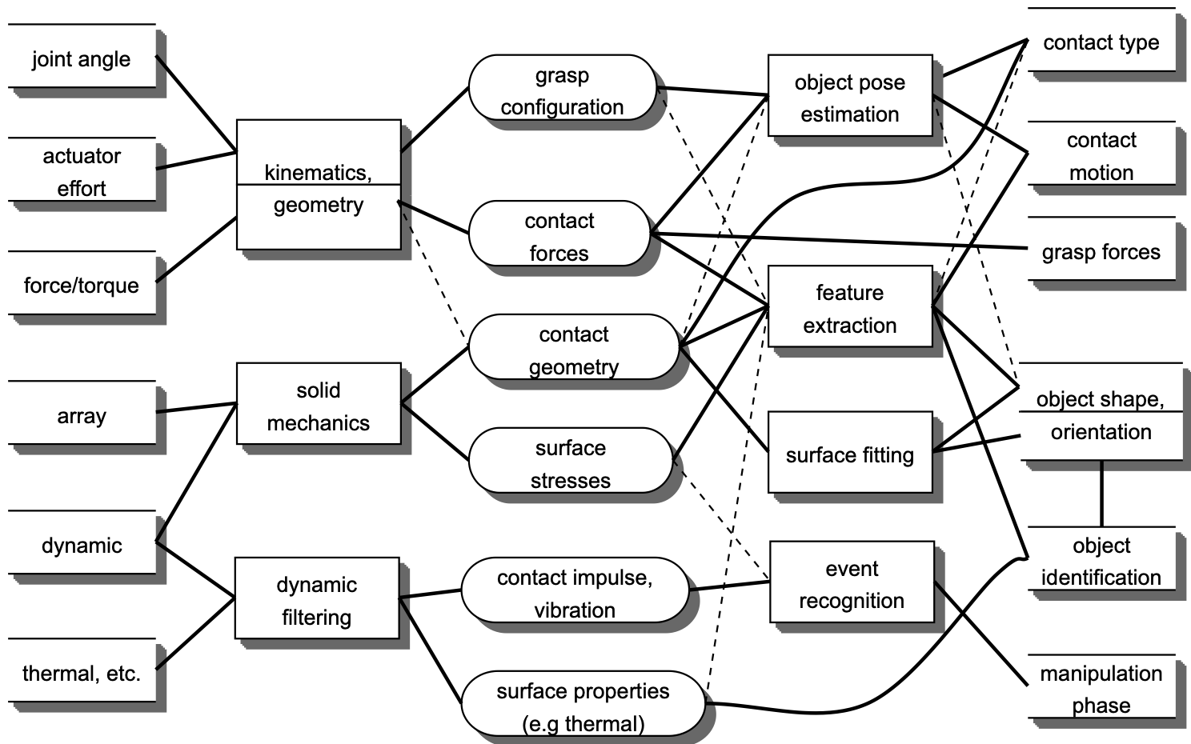
From sensed quantities to information
high-level
information
sensor

Slide 27
From sensed quantities to information
high-level
information
sensor
transformation

Slide 28
From sensed quantities to information
high-level
information
sensor
transformation
low-level
information

Slide 29
From sensed quantities to information
high-level
information
sensor
transformation
low-level
information
interpretation

Slide 30
Which tactile sensor(s) to choose? (It’s complicated!)
Technology options:
Design criteria:
Piezoresistive
Capacitive
Piezoelectric
Optical
Quantum tunnel composite (QTC)
Barometric (i.e. using a fluid)
Multi-modal (e.g. adding thermal)
Structure-borne sound
Spatial resolution
Sensitivity
Frequency response
Hysteresis
Wiring considerations
Flexibility (i.e. conforming to robot)
Surface properties (e.g. friction, compliance)
Robustness
Z. Kappassov, J.-A. Corrales, V. Perdereau, Tactile sensing in dexterous robot hands - Review, Robotics and Autonomous Systems, 2015.

Slide 31
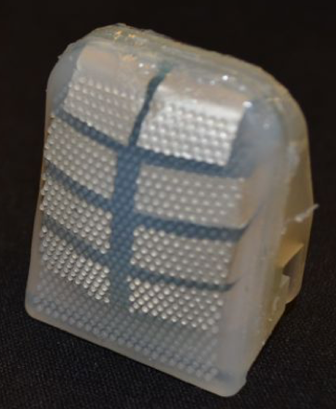
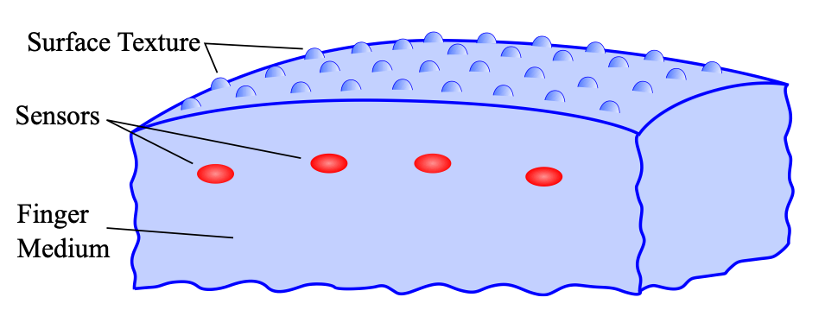
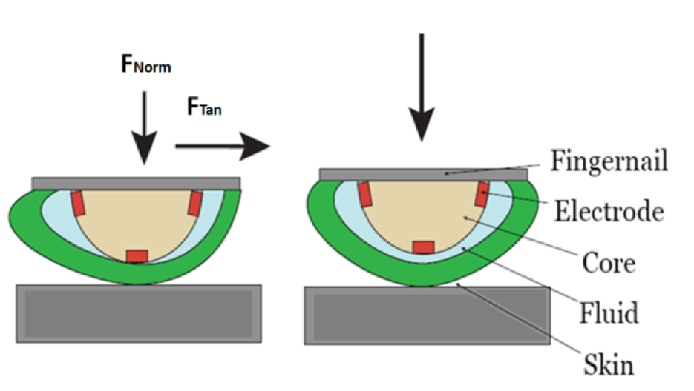

Few sensors measure stress directly
PVDF is much stiffer than surrounding silicone rubber, hence it essentially measures stresses in the material
In each case, the “receptive field” depends on skin design and sensor depth.
Other sensors essentially measure strains within the skin or finite deformations of the skin surface
BioTac sensor concept

Slide 32
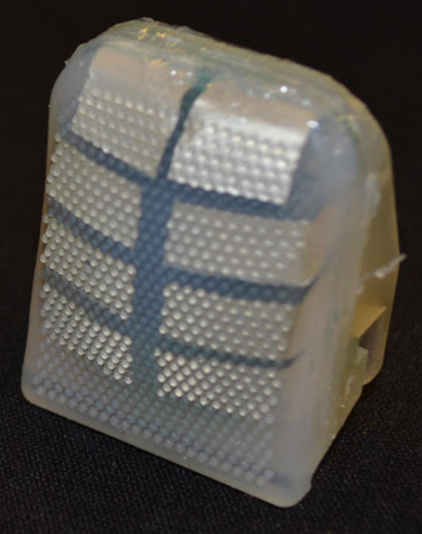
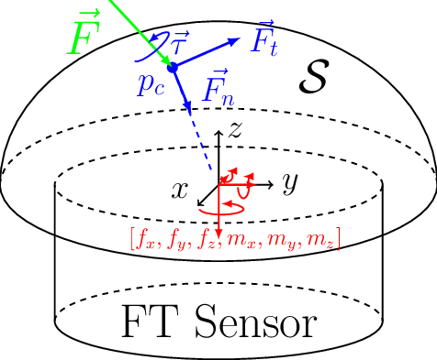
(Enrico)
Extrinsic versus Intrinsic contact sensing
GOAL → Location of the contact between the object and the robot fingertip
Array Tactile Sensing
Force-Torque Contact Sensing
Notes:
We consider simple signal processing algorithms that are easily executed in real time, and include the effects of noise, vibrations, and other disturbances which are inevitably present in real task execution.

Slide 33
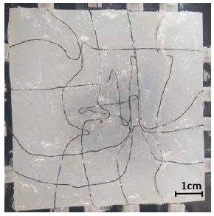
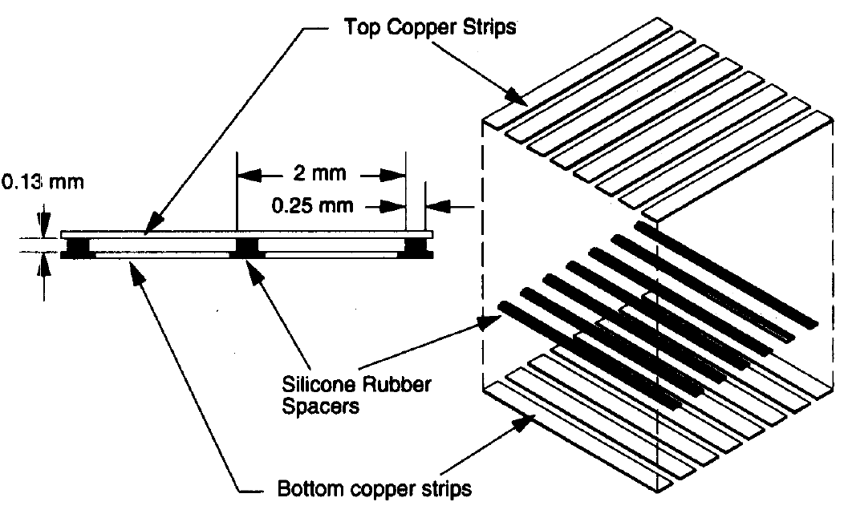
Array Tactile Sensing
Tactile array sensors measure the distribution of pressure across the fingertip
Contact location
Object shape
Effective width of the pressure distribution
Etc.
T.J. Thuruthel, J. Hughes, F. Iida (2020). Joint Entropy-Based Morphology Optimization of Soft Strain Sensor Networks for Functional Robustness. IEEE Sensors Journal, 20 (18).
J.S. Son, M.R. Cutkosky, R.D. Howe (1996). Comparison of contact sensor localization abilities during manipulation. Robotics and Autonomous System 17, pp. 217-233.

Slide 34
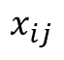
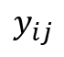
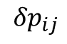
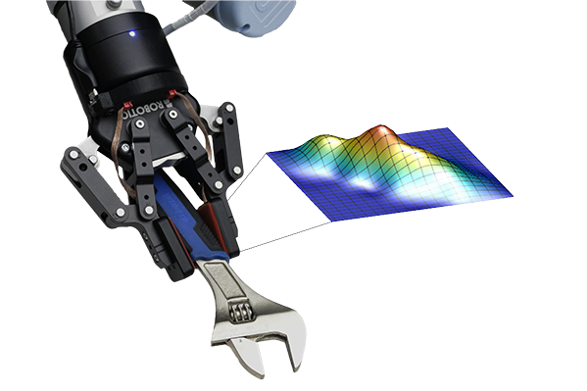
Array Tactile Sensing
j = 1
j = n
i = 1
 |  | i j
i = m
m x n array

Slide 35
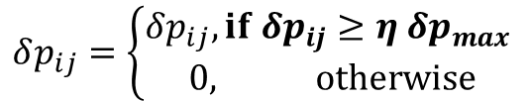
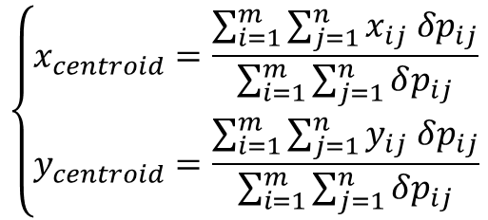
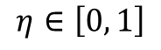
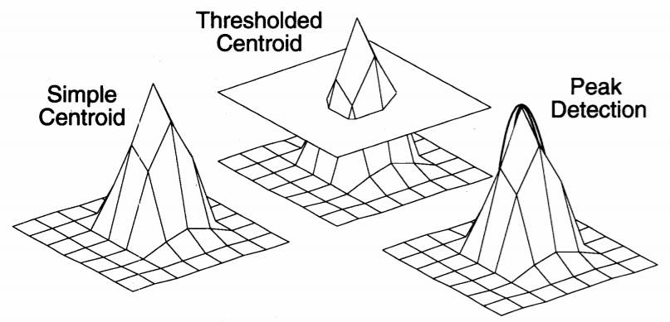
Array Tactile Sensing
1
Fit a quadratic curve
to three points
around the maximum strain taxel
2
Center of pressure
J.S. Son, M.R. Cutkosky, R.D. Howe (1996). Comparison of contact sensor localization abilities during manipulation. Robotics and Autonomous System 17, pp. 217-233.

Slide 36
Array Tactile Sensing
1
Fit a quadratic curve
to three points
around the maximum strain taxel
2
Center of pressure
J.S. Son, M.R. Cutkosky, R.D. Howe (1996). Comparison of contact sensor localization abilities during manipulation. Robotics and Autonomous System 17, pp. 217-233.

Slide 37
Array Tactile Sensing
1
Fit a quadratic curve
to three points
around the maximum strain taxel
2
Center of pressure
J.S. Son, M.R. Cutkosky, R.D. Howe (1996). Comparison of contact sensor localization abilities during manipulation. Robotics and Autonomous System 17, pp. 217-233.

Slide 38
Array Tactile Sensing
What happens in case of shear forces?
large area contacts
# of elements
point contacts
noise sensitivity
+
-
J.S. Son, M.R. Cutkosky, R.D. Howe (1996). Comparison of contact sensor localization abilities during manipulation. Robotics and Autonomous System 17, pp. 217-233.
Notes:
The algorithm used should be tailored to the expected contact conditions (e.g., point contact, large area contact, etc.)

Slide 39
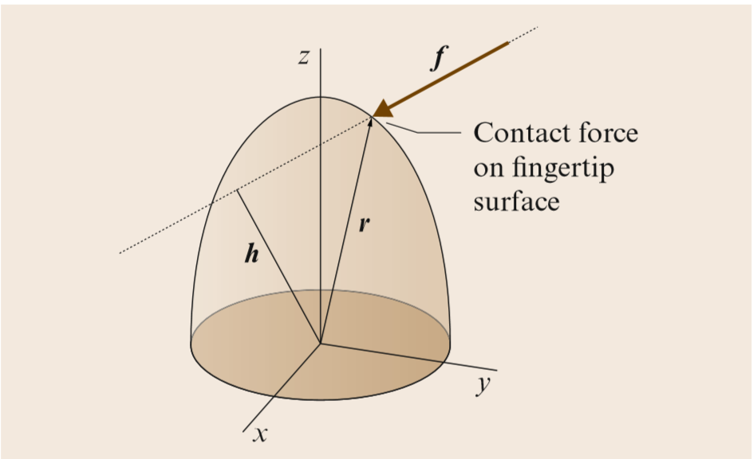
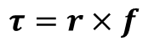
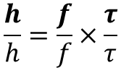
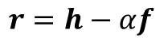

Intrinsic Contact Sensing
1
Geometry of the fingertip is known
Contact force magnitude and location
2
6-axis force-torque sensor
h is the lever arm perpendicular to the line of action of f
M.R. Cutkosky, W. Provancher (2008). Force and Tactile Sensing. Springer Handbook of Robotics, pp. 717-736. Springer, Cham. -- reviewing original articles by Bicchi, Salisbury
Notes:
This method holds only in case of no torques transmitted at contact -> soft finger [A. Bicchi (1990). Intrinsic Contact Sensing for Soft Fingers]

Slide 40
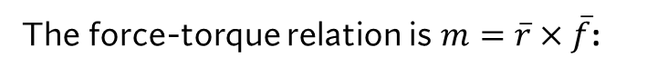








Intrinsic Contact Sensing
The fingertip shape is circular:
Polar coordinates are used:
Planar case
The maximum moment generated
through the finger radius is limited
J.S. Son, M.R. Cutkosky, R.D. Howe (1996). Comparison of contact sensor localization abilities during manipulation. Robotics and Autonomous System 17, pp. 217-233.
Notes:
The manipulator operates in the plane and the cylindrical finger tip is oriented to form a circular cross section in the plane, the origin of the coordinate frame was located at the center of the finger tip.
The force sensor values must be checked before applying this ICS algorithm.

Slide 41



Intrinsic Contact Sensing
Planar case
J.S. Son, M.R. Cutkosky, R.D. Howe (1996). Comparison of contact sensor localization abilities during manipulation. Robotics and Autonomous System 17, pp. 217-233.

Slide 42

Extrinsic versus Intrinsic contact sensing
Two manipulation tasks:
rotate the object about its center
move the object at high speed
Tasks generate significant shear forces
and inertial forces
J.S. Son, M.R. Cutkosky, R.D. Howe (1996). Comparison of contact sensor localization abilities during manipulation. Robotics and Autonomous System 17, pp. 217-233.

Slide 43

Extrinsic versus Intrinsic contact sensing
What is the expected trace for contact localization?
box
pin

Slide 44
Extrinsic versus Intrinsic contact sensing
What is the expected trace for contact localization?
box
pin
3
3
2
2
1
1
Contact Location [mm]
Contact Location [mm]
0
0
-1
-1
-2
-2
-3
-3
Time [s]
Time [s]

Slide 45


Extrinsic versus Intrinsic contact sensing
ICS is affected by accelerations
Intrinsic Contact Sensing
Simple Centroid
Thresholded Centroid
Peak detection
J.S. Son, M.R. Cutkosky, R.D. Howe (1996). Comparison of contact sensor localization abilities during manipulation. Robotics and Autonomous System 17, pp. 217-233.

Slide 46

Extrinsic versus Intrinsic contact sensing
ICS is affected by accelerations
Shear forces affect arrays
Intrinsic Contact Sensing
Simple Centroid
Thresholded Centroid
Peak detection
J.S. Son, M.R. Cutkosky, R.D. Howe (1996). Comparison of contact sensor localization abilities during manipulation. Robotics and Autonomous System 17, pp. 217-233.
Notes:
A correlation exists between spikes in the ICS plot and the accelerations at corners.
Triangular deviations of the ICS are due to calibration difficulties. Peaks are generated when the shear force changes its direction (i.e., high accelerations affect ICS).

Slide 47
Tactile events in manipulation tasks
fingers contact object
object makes or breaks contact with surface
contact
released
[Johansson, Flanagan, ‘09]

Slide 48


Extrinsic versus Intrinsic contact sensing
ICS is affected by accelerations
Shear forces affect arrays
Max accuracy of ICS
often way better
Intrinsic Contact Sensing
Simple Centroid
Thresholded Centroid
Peak detection
J.S. Son, M.R. Cutkosky, R.D. Howe (1996). Comparison of contact sensor localization abilities during manipulation. Robotics and Autonomous System 17, pp. 217-233.

Slide 49
Extrinsic versus Intrinsic contact sensing
hardware complexity
-
+
calibration complexity
+
-
 | Shear | Inertia
ICS | U | A
Array | A | U
The estimation is
U = unaffected
A = affected
Notes:
The ICS algorithm might be more robust:
if it is thresholded, a more reliable contact location during initial contact is obtained
the inertial forces are reduced if a smooth trajectory is used (i.e., accelerations are reduced)
the fingertip mass should be reduced, since it is the only component which affects inertial forces
Anyway, both of these sensing schemes can provide contact localization accuracy of less than a millimeter in real manipulation tasks.

Slide 50
(Gojko)

Slide 51


GelSight
Optical sensor with deformable elastomer
Geometry sensing
High spatial resolution
Independent from optical properties of the object
W. Yuan, S. Dong, E. H. Adelson, GelSight: High-Resolution Robot Tactile Sensors for Estimating Geometry and Force, 2017.

Slide 52

Challenges addressed
Measurement of shear force
Detecting contact area
Hardware optimization
Fabrication

Slide 53


Marker Motion for Force Measurement
Magnitude of the motion is roughly proportional to force
In (b) when the shear load increases until slip occurs

Slide 54

Tactile Sensing for Object Localization
Given known object geometry, use combinations of imprints seen in contact sensors to determine the object pose.
Once in contact with the object, place the sensors on features that will continue to give useful information for localization.
F. Hogan, J. Ballester, S. Dong, A. Rodriguez, Tactile Dexterity: Manipulation Primitives with Tactile Feedback, ICRA, 2020.

Slide 55

Example of tactile-based manipulation
GelSlim palms
[Hogan, et. al. ‘17]

Slide 56


Slide 57



Detecting Slip - translation
Measure of marker displacement nonhomogeneity

Slide 58

Detecting Slip - rotation
Slip again occurs at the periphery first
Human finger

Slide 59

Slip Sensing to Detect Off-Nominal Events
[Hogan, et. al. ‘17]

Slide 60
From sensed quantities to information
high-level
information
sensor
transformation
low-level
information
interpretation

Slide 61




DIGIT
Low-cost
Open-source
Compact

Slide 62

DIGIT - marble rolling

Slide 63

DIGIT - marble rolling
Proposed approach provides a more effective controller
However, due to control noise and difficulty of the task, there is 75% success rate

Slide 64
For the remaining slides - see how many of them we really want to do this week. This week should focus mainly on the sensor - how it works, what information it can provide, etc.
Ideally make a backward reference to slide 15

Slide 65

Splitting Up a Manipulation Task
Tactile feedback localizes object to allow planning a nominal contact trajectory
Use grasp equation, friction constraints to design stable end-effector trajectory to track the contact trajectory
[Hogan, et. al. ‘17]

Slide 66







Generating an End-Effector Trajectory
We review this the last week for motion planning. For this week focus on the sensing aspect
Object, palm poses
Contact point wrenches
(for point contacts)
Normal and tangential forces

Slide 67




Increasing Stability Margin after Slip
Nonconvex
Approximate stability margin
Robot palm poses
Linearize grasp equation
Think of α as the tolerable decrease in normal force before slip
Convex
[Hogan, et. al. ‘17]

Slide 68

Increasing Stability Margin after Slip
[Hogan, et. al. ‘17]

Slide 69

Exercise for Week 8 (the ultimate assignment...)
We consider intrinsic contact sensing and, more generally, the “Sim2Real” problem of tactile sensing:
Tactile data are inherently somewhat noisy due to contact phenomena (slipping, rolling, making/breaking contact, vibrations, etc.)
Therefore, reconstruction of desired quantities -- like the trajectory of a contact patch during manipulation -- can be challenging.
We provide “clean” and “noisy” tactile data and you write a program to do the intrinsic contact sensing (ICS) solution and examine the effects of noise.
Compare the output results with the given simulated input.

